Slide 1
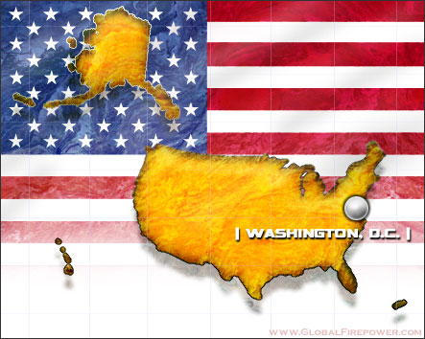
Do Now:
Create a list of businesses that are vital to the well being of our country and the economy
Notes:
What are the advantages of a country controlling those businesses?

Slide 2
Economic Goals
Socialist Principles
1947 Independence, India’s new leaders wanted to reduce their economic dependence
Nehru adopted socialist principles regulating the economy and limited foreign investment
India now has a mixed economy where the government controls some industries but also allows private ownership
Mixed Economy

Slide 3
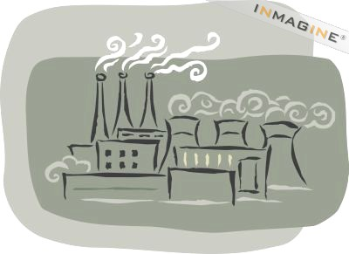
Growth
Income from cash crops and taxes have been used to build industries such as steel factories and hydro-electric plants (India’s new temples)
The 1990s, India’s government began encouraging foreign investment

Slide 4
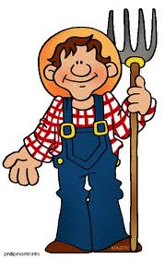
Farming is the heart of the Indian economy
Most Indians are subsistence farmers
The government set up irrigation systems because the monsoons are not dependable and don’t always arrive on time

Slide 5
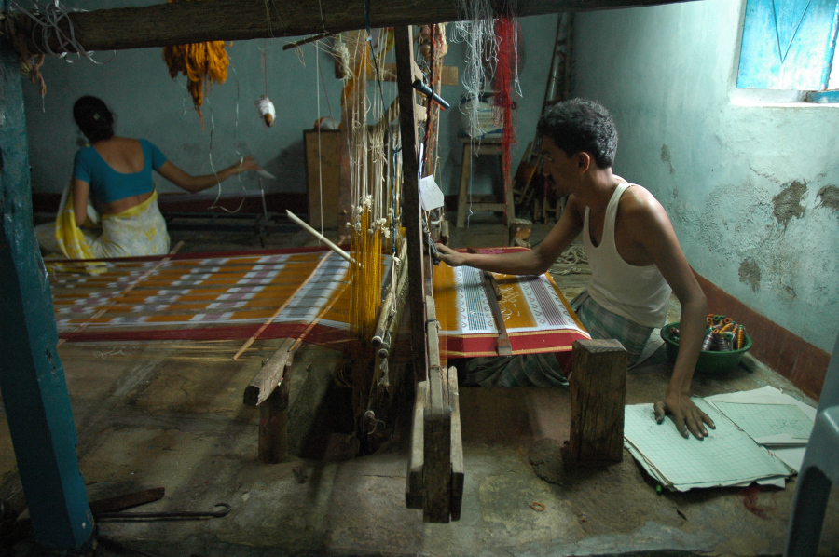
Village Life
In some ways, life has changed very little
Only half have electricity and few have running water
People produce handmade goods in cottage industries
Notes:
Cottage industry is small business run from their home

Slide 6
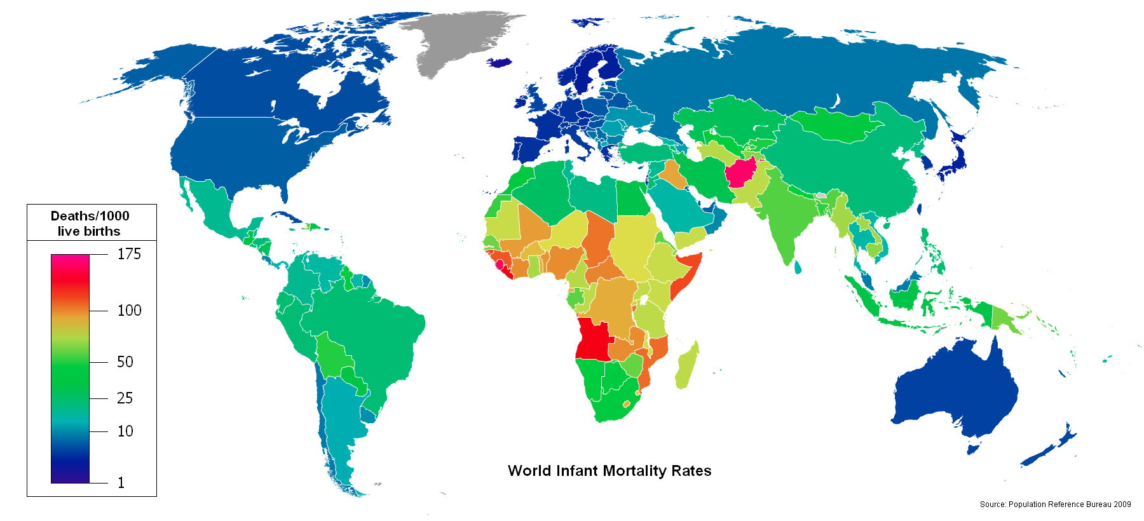
Green Revolution has improved harvests
Satellite Dishes are popping up across India
Travel continues to become easier
The government has done things to improve health care
  Infant mortality rate is declining
Infant Mortality Rate
Notes:
Health care has improved because wells are dug deeper and water is cleaner
Health clines bring better medical care to rural areas

Slide 7
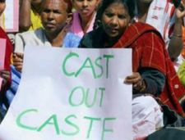
Modernization and the Caste System
People still tend to associate with members of their own caste
Caste continues to affect occupation
  Family connections make networking very easy
Some changes have occurred and people from different castes mix more freely
Notes:
Former untouchables might be allowed to draw water from the village well
And worship at the village temple

Slide 8
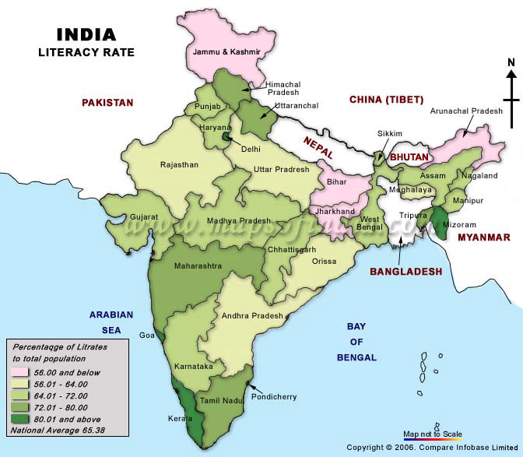
Education
Schooling is free for children up to age 14
In reality, social attitudes affect who gets an education
80% of elementary age children get some schooling
35% of Indians are literate

Slide 9
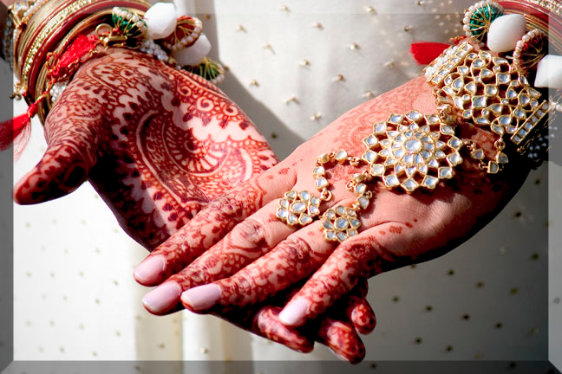
Family Life
Marriage is occurring at a later age
Parents still arrange about 95% of marriages
Educated young couples tend to reject the joint family tradition
Women are still subordinate to men
Notes:
10% of women hold positions in government

Slide 10
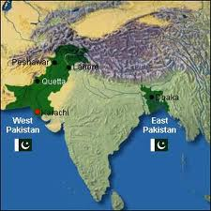
Pakistan Since Independence
In 1947, Pakistan was made up of two regions
  West and East Pakistan (separated by 1,000 miles)
Civil War occurred because of political turmoil
The East felt underrepresented in Parliament and when they did win a majority the government refused to accept the election results

Slide 11
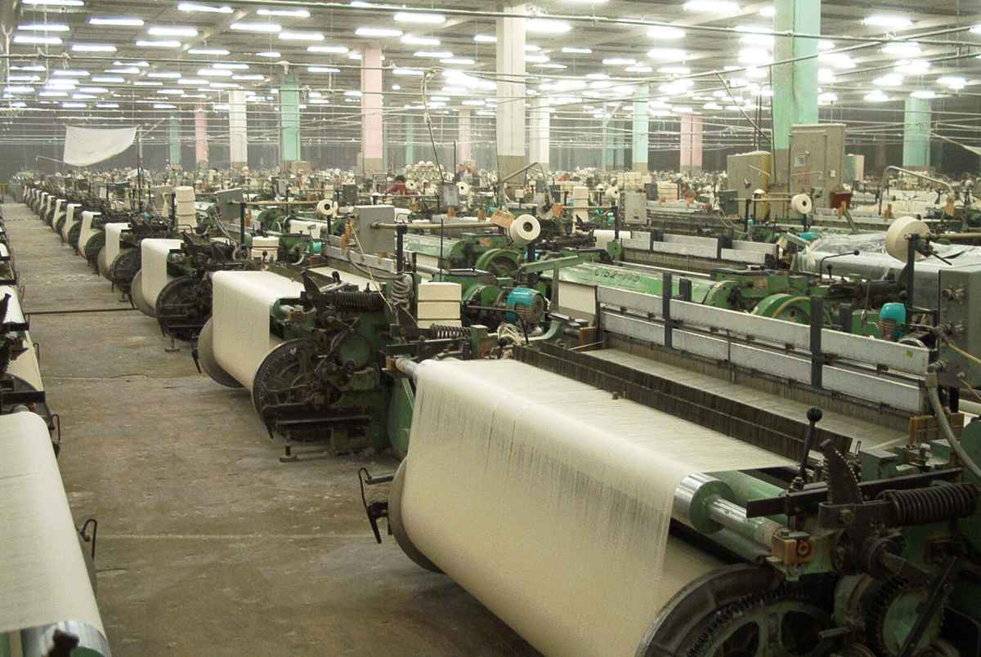
In 1971, East Pakistan became the independent nation of Bangladesh
After the civil war, Pakistan began to modernize
The government devoted most of the nation’s resources to developing agriculture

Slide 12
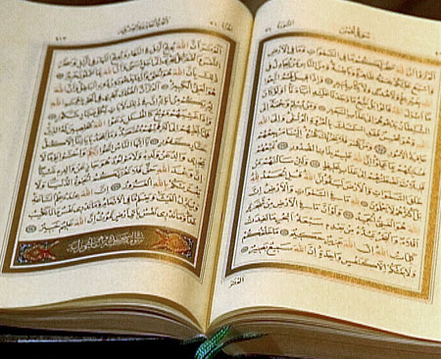
Forces for Change
Pakistan’s population and cities are growing rapidly
Illiteracy is high and many live in poverty
Pakistan has experienced long periods of military rule
Pakistan has also felt the effects of Islamic Fundamentalism

Slide 13
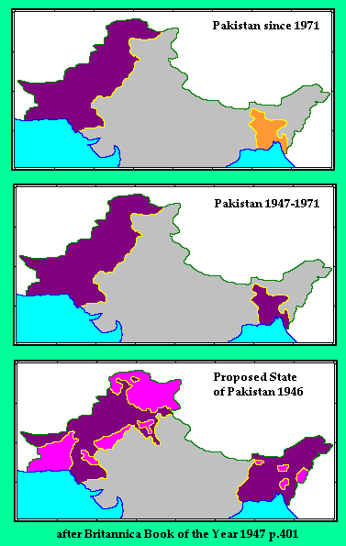
Bangladesh
Densely populated with more than 120 million people living in an area of about the size of Wisconsin
Natural Disasters threaten the country constantly and have limited progress there

Slide 14
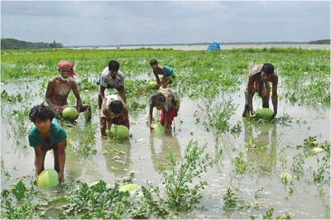
Bangladesh has little money for development because the price for cash crops has dropped
Bangladesh has few roads and bridges and most travel is by boat
Without aid, Bangladesh can’t improve it communication and transportation systems

Slide 15
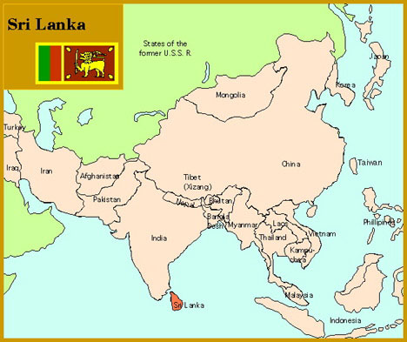
Sri Lanka
The economy is based on cash crops such as rubber, tea, and coconuts
Sri Lanka has a literacy rate of over 75%
70% of Sri Lankans speak Sinhalese and practice Buddhism
18% speak Tamil and practice Hinduism

Slide 16
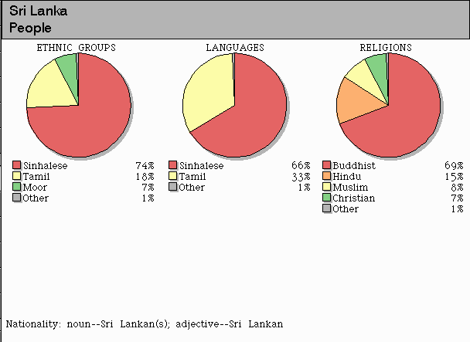
Ethnic Tensions
Tamil-Sinhalese tensions grew in the 1970s
The Tamil claimed they were discriminated against
Tamil called upon government action but when change failed to occur they launched a guerilla war

Slide 17
In the early years of the war, India supported the Tamil
Later, India changed its stance and sent troops to help Sri Lanka fight the Tamil minority
Tamil guerillas responded by assassinating Prime Minister Gandhi in 1991

Slide 18
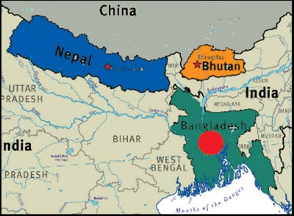
Smaller Nations of the Subcontinent
Bhutan and Nepal are landlocked
Bhutan is a monarchy and most of its people are Buddhists
Most of Nepal is Hindu and until recently they were a monarchy whose King ruled with absolute power

