Slide 1
Do Now: What does he mean?
“The British want us to put the struggle on the plane of machine guns… Our only assurance of beating them is to keep it… where we have the weapons and they have not.”
  Mahatma Gandhi

Slide 2
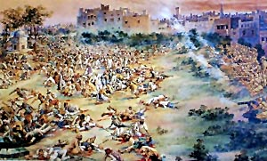
Chapter 9
Growing Unrest
Demand for Home Rule after WWI was growing
In 1919, Britain responded with harsh new laws limiting freedom
  Public gatherings were banned
4/13/19- 10,000 Indians gathered in a public area in Amritsar, India and British troops shot and killed more than 379 Indians
Amritsar Massacre

Slide 3
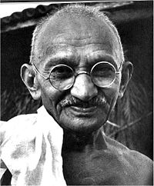
Mohandas Gandhi
Gandhi emerged as a key figure in the Indian struggle for independence
He inspired the common people of India to work for change
He came from a middle class Hindu family

Slide 4
Gandhi studied law in England before returning to India (1891) to practice law
He had little success in India so he left for South Africa
He believed in Civil Disobedience(Satyagraha: truth force)
Truth Force

Slide 5
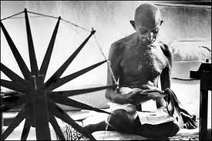
He gave up western ways and encouraged traditional Indian industries, such as spinning cotton
He was a vegetarian and he often fasted
He encouraged Indians to boycott British made goods
  Salt March of 1930

Slide 6
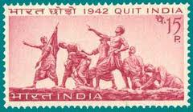
Independence
When WWII began most Indians had no desire to fight
The INC refused to support the war unless Britain promised immediate independence
When the British refused, Gandhi and others organized the “Quit India” movement

Slide 7
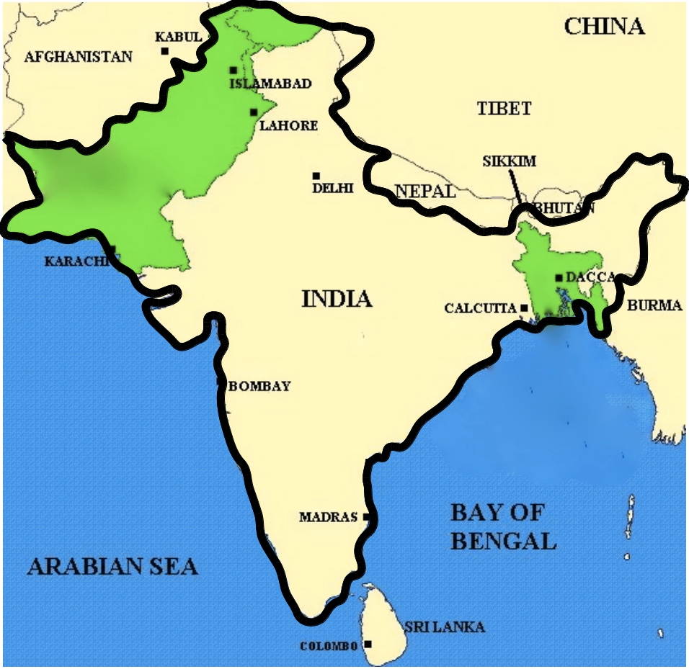
Hindu-Muslim Conflict
During the 1920s and 1930s, division grew between the two religious groups
The British encouraged the conflict, hoping to weaken the nationsalists
Muslim leader Muhammad Ali Jinnah demanded a separate Muslim nation
Notes:
Gandhi hoped the two groups could work things out and live together.
Hindus did not trust muslims and looked at them as being foreign conquerors

Slide 8
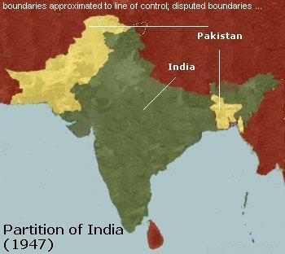
Subcontinent Divided
Widespread rioting broke out between Hindus and Muslims in 1946
In 1947, the British passed the Indian Independence Act ending British rule and splitting the subcontinent into two independent nations

Slide 9
Partition
Hindu led India led by Jawaharlal Nehru
Muslim led Pakistan led by Ali Jinnah
Partition led to violence and more than 500,000 people died in the fighting
Gandhi was murdered by a Hindu extremist
  “The light has gone out of our lives… There is darkness everywhere.”
      Nehru
Notes:
Hindu extremist believed Gandhi betrayed his people

Slide 10
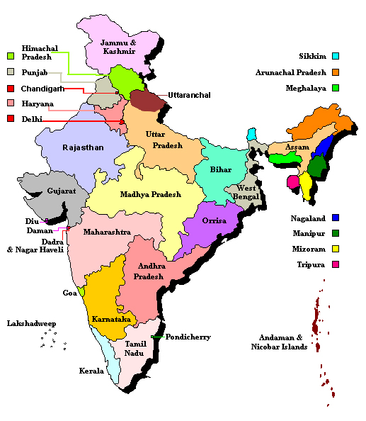
India’s Government
1949, Indian leaders drew up a constitution
The constitution created a federal system consisting of a central government , 25 states, and 7 territories
The president of India appoints state governors

Slide 11
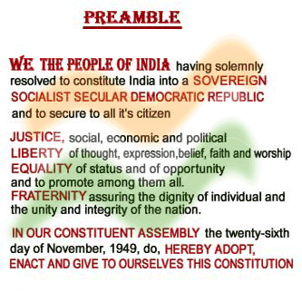
Under the constitution, India is a parliamentary democracy
  President is the head of state but the real power lies with the political party that controls the most seats in parliament
  The Prime Minister is the leader of that political party

Slide 12
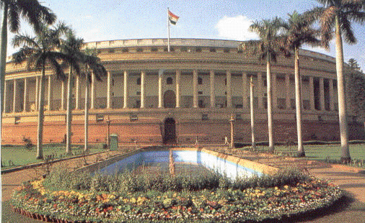
Parliament has two houses
  Upper House is called Rajya Sabha (chosen by state legislatures)
  House of the People is the Lok Sabha (voters choose its’ members
A coalition is formed if no party wins a majority where several parties join to rule

Slide 13
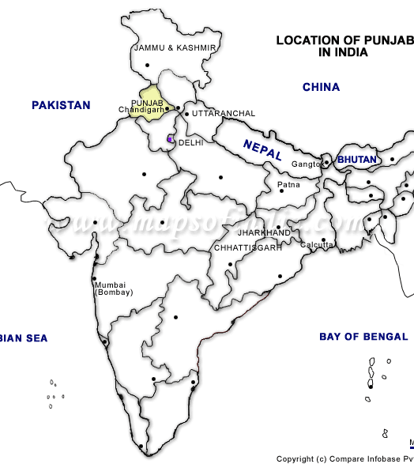
Dividing Forces
Sikh separatism
  Religion that blends Islam and Hinduism that teaches the belief in one god and rejects the caste system (2% of the population)
  Sikh separatists feel alienated and want to break away
  They have a majority in Punjap, northwestern state and have staged violent protests

Slide 14
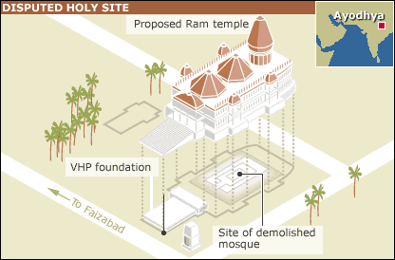
Hindu- Muslim Conflict
The conflict continues to plague India
Many Muslims fled to Pakistan at the time of independence but about 100 million Muslims still live in India
Ayodhya is home to a Muslim Mosque where Hindus claim the site was the birthplace of the god Rama

